Slide 1
Lecture 10 Relational Database Design
BCNF
Good Design
Atomic
Dependencies
BCNF
3rdNF
MVDs
Design Process
United International College

Slide 2
Outline
Good Design
Atomic
Dependencies
BCNF
3rdNF
MVDs
Design Process
Features of Good Relational Design
Atomic Domains and First Normal Form
Functional Dependency Theory
BCNF
3rd Normal Form
Multivalued Dependencies and Decomposition
Database-Design Process

Slide 3
Motivation of Decompositions
Good Design
Atomic
Dependencies
BCNF
3rdNF
MVDs
Design Process
To remove the redundancy in the database, we intend to decompose the schema into normal forms.
The ideal decomposition satisfies the following conditions
  the redundancy is minimized (recall the example given in the section “Good Design”);
  the decomposition is lossless; and
  the dependencies are preserved.

Slide 4

Lossless-join Decomposition
Good Design
Atomic
Dependencies
BCNF
3rdNF
MVDs
Design Process
For the case of $R=R_{1}∪R_{2}$, a decomposition of $R$ into $R_{1}$ and $R_{2}$ is lossless join if and only if at least one of the following dependencies is in $F^{+}$:
  $R_{1}∩R_{2}→R_{1}$
  $R_{1}∩R_{2}→R_{2}$

Slide 5
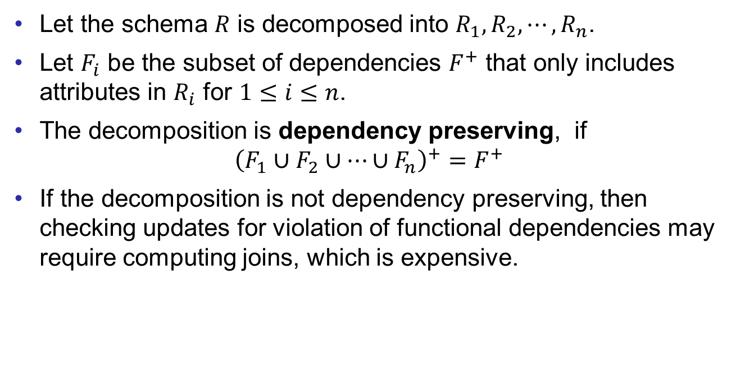
Dependency Preservation
Good Design
Atomic
Dependencies
BCNF
3rdNF
MVDs
Design Process
Let the schema $R$ is decomposed into $R_{1},R_{2},⋯,R_{n}$.
Let $F_{i}$ be the subset of dependencies $F^{+}$ that only includes attributes in $R_{i}$ for $1≤i≤n$.
The decomposition is dependency preserving, if
$${\left(F_{1}∪F_{2}∪…∪F_{n}\right)}^{+}=F^{+}$$
If the decomposition is not dependency preserving, then checking updates for violation of functional dependencies may require computing joins, which is expensive.

Slide 6
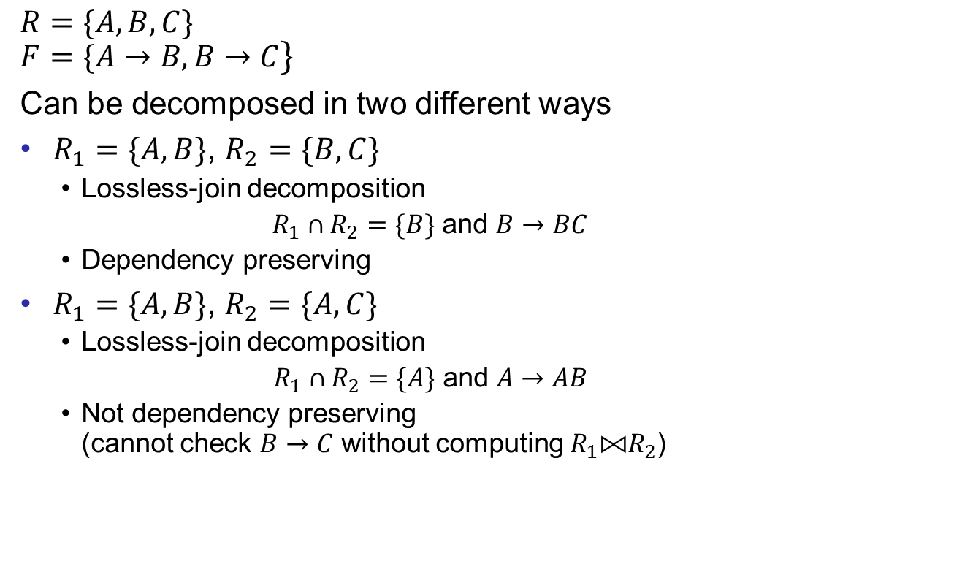
Example
Good Design
Atomic
Dependencies
BCNF
3rdNF
MVDs
Design Process
$R=\{A, B, C\}$
$F=\{A→B, B→C\}$
Can be decomposed in two different ways
$R_{1}=\{A, B\}$, $R_{2}=\{B, C\}$
  Lossless-join decomposition
  $R_{1}∩R_{2}=\{B\}$ and $B→BC$
  Dependency preserving
$R_{1}=\{A, B\}$, $R_{2}=\{A, C\}$
  Lossless-join decomposition
  $R_{1}∩R_{2}=\{A\}$ and $A→AB$
  Not dependency preserving
  (cannot check $B→C$ without computing $R_{1}⨝R_{2}$)

Slide 7
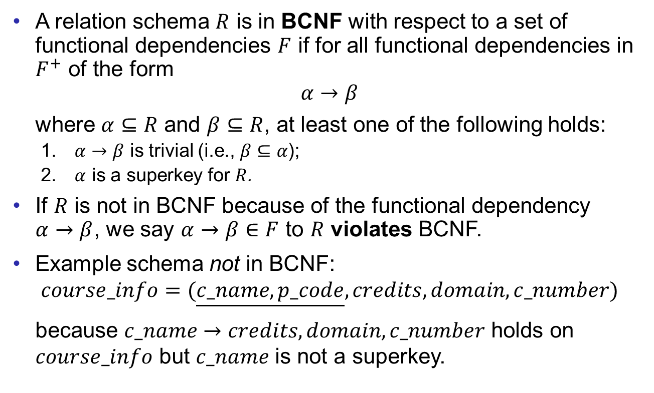
Boyce-Codd Normal Form
Good Design
Atomic
Dependencies
BCNF
3rdNF
MVDs
Design Process
A relation schema $R$ is in BCNF with respect to a set of functional dependencies $F$ if for all functional dependencies in $F^{+}$ of the form
$$α→β$$
where $α⊆R$ and $β⊆R$, at least one of the following holds:
  $α→β$ is trivial (i.e., $β⊆α$);
  $α$ is a superkey for $R$.
If $R$ is not in BCNF because of the functional dependency $α→β$, we say $α→β∈F$ to $R$ violates BCNF.
Example schema not in BCNF:
$$course_info=(\underline{c_name,p_code},credits,domain,c_number)$$
because $c_name→credits,domain,c_number$ holds on $course_info$ but $c_name$ is not a superkey.

Slide 8
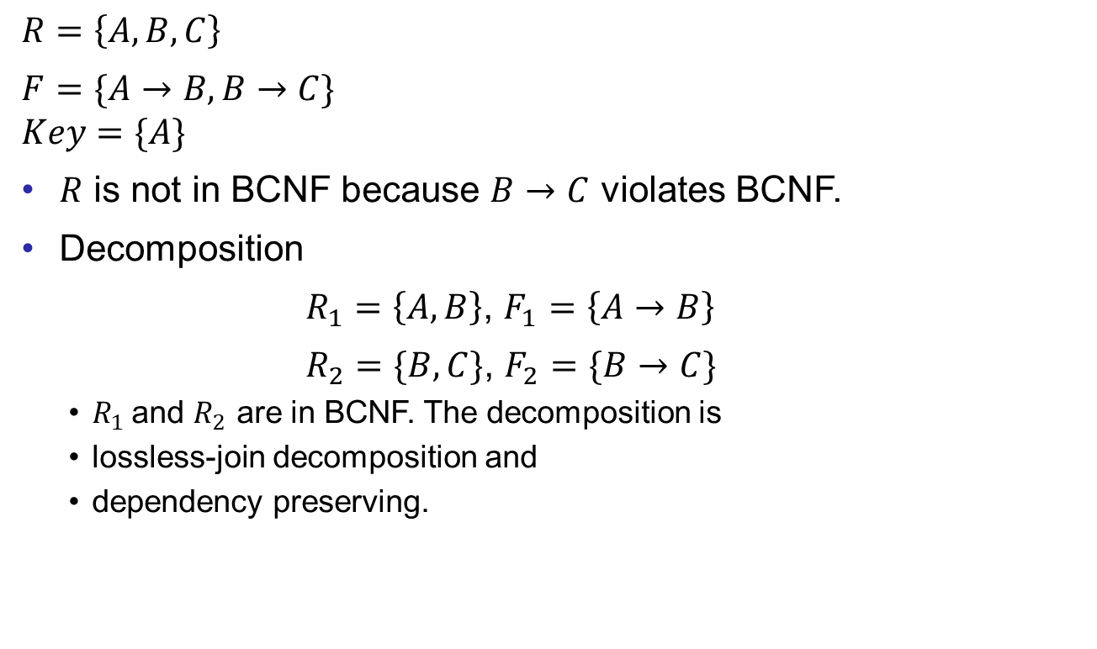
Example
Good Design
Atomic
Dependencies
BCNF
3rdNF
MVDs
Design Process
$R=\left\{A, B, C\right\}$
$F=\{A→B, B→C\}$
$Key=\{A\}$
$R$ is not in BCNF because $B→C$ violates BCNF.
Decomposition
$R_{1}=\left\{A, B\right\}$, $F_{1}=\left\{A→B\right\}$
$R_{2}=\{B, C\}$, $F_{2}=\{B→C\}$
  $R_{1}$ and $R_{2}$ are in BCNF. The decomposition is
  lossless-join decomposition and
  dependency preserving.

Slide 9
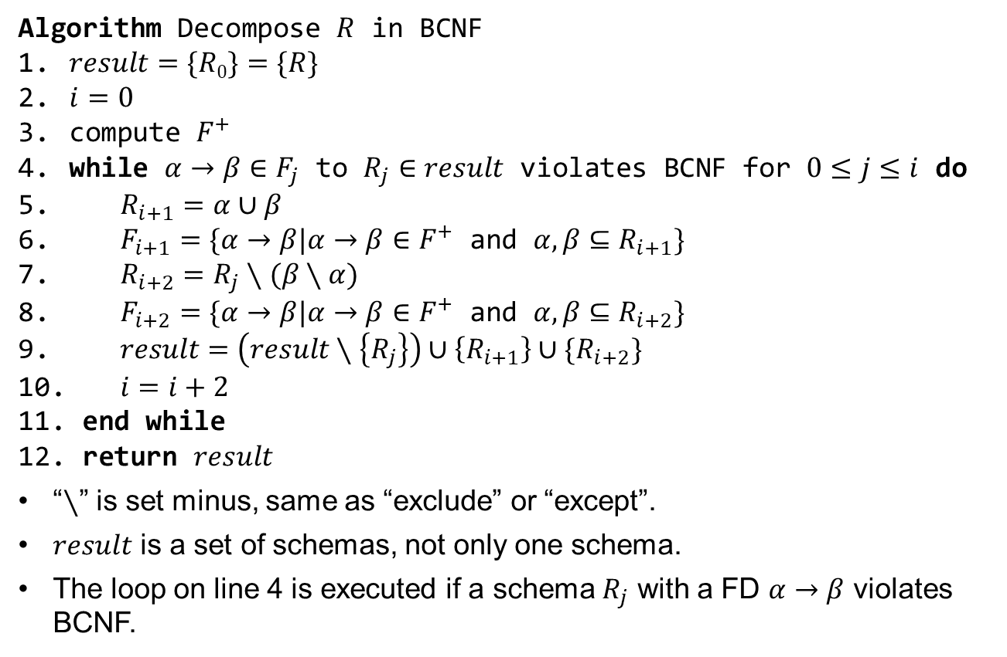
BCNF Decomposition Algorithm
Good Design
Atomic
Dependencies
BCNF
3rdNF
MVDs
Design Process
Algorithm Decompose $R$ in BCNF
$result=\{R0\}=\{R\}$
$i=0$
compute $F^{+}$
while $α→β∈F_{j}$ to $R_{j}∈result$ violates BCNF for $0≤j≤i$ do
$R_{i+1}=α∪β$
$F_{i+1}=\{α→β|α→β∈F^{+}$ and $α,β⊆R_{i+1}\}$
$R_{i+2}=R_{j}∖(β∖α)$
$F_{i+2}=\{α→β|α→β∈F^{+}$ and $α, β⊆R_{i+2}\}$
$result=\left(result∖\left\{R_{j}\right\}\right)∪\left\{R_{i+1}\right\}∪\{R_{i+2}\}$
$i=i+2$
end while
return $result$
“∖” is set minus, same as “exclude” or “except”.
$result$ is a set of schemas, not only one schema.
The loop on line 4 is executed if a schema $R_{j}$ with a FD $α→β$ violates BCNF.
Notes:
Step 6 & 8 are computing the restriction of D to R_{i} referred to pg 71.

Slide 10
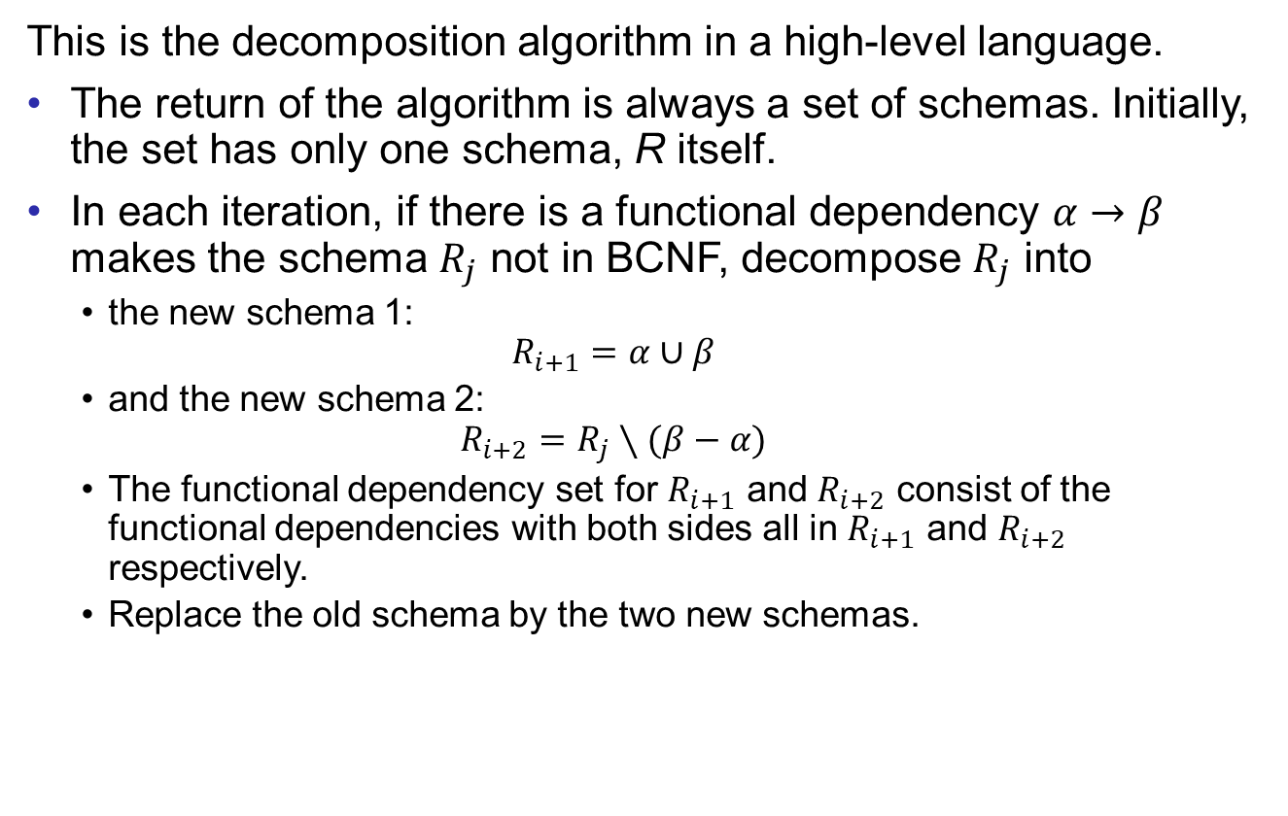
BCNF Decomposition Algorithm
Good Design
Atomic
Dependencies
BCNF
3rdNF
MVDs
Design Process
This is the decomposition algorithm in a high-level language.
The return of the algorithm is always a set of schemas. Initially, the set has only one schema, R itself.
In each iteration, if there is a functional dependency $α→β$ makes the schema $R_{j}$ not in BCNF, decompose $R_{j}$ into
  the new schema 1:
  $$R_{i+1}=α∪β$$
  and the new schema 2:
  $$R_{i+2}=R_{j}∖(β−α)$$
  The functional dependency set for $R_{i+1}$ and $R_{i+2}$ consist of the functional dependencies with both sides all in $R_{i+1}$ and $R_{i+2}$ respectively.
  Replace the old schema by the two new schemas.

Slide 11
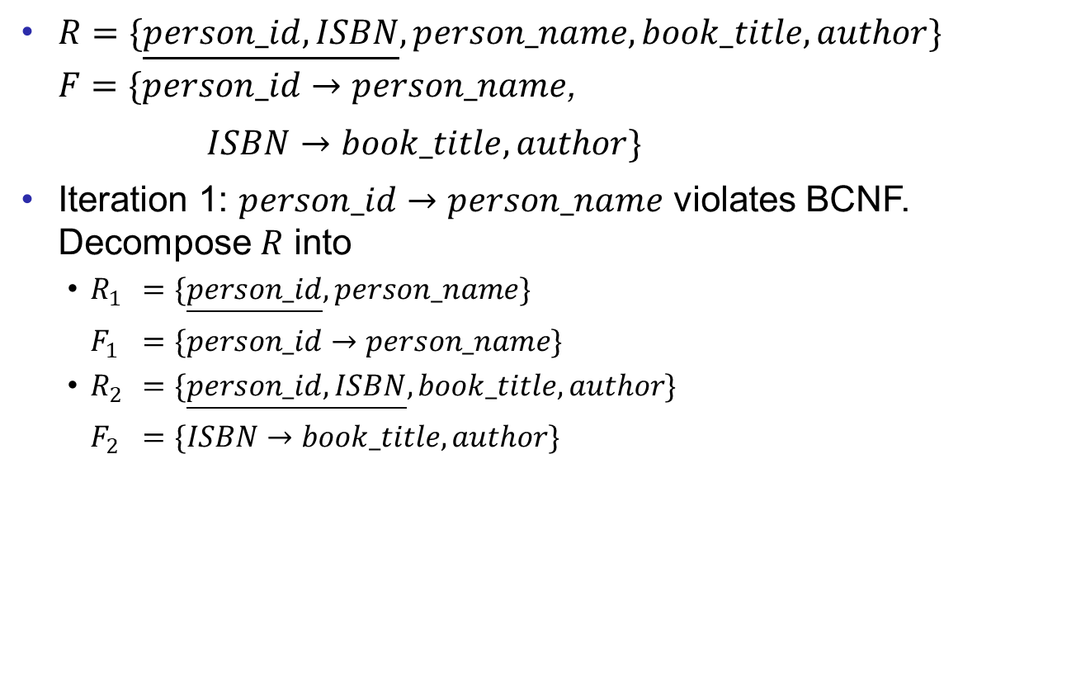
BCNF Example
Good Design
Atomic
Dependencies
BCNF
3rdNF
MVDs
Design Process
$R=\{\underline{person_id, ISBN}, person_name,book_title,author\}$
$F=\{person_id→person_name$,
$ISBN→book_title,author\}$
Iteration 1: $person_id→person_name$ violates BCNF. Decompose $R$ into
  $R_{1}$ $=\{\underline{person_id}, person_name\}$
  $F_{1}$ $=\{person_id→person_name\}$
  $R_{2}$ $=\{\underline{person_id,ISBN}, book_title,author\}$
  $F_{2}$ $=\{ISBN→book_title,author\}$

Slide 12
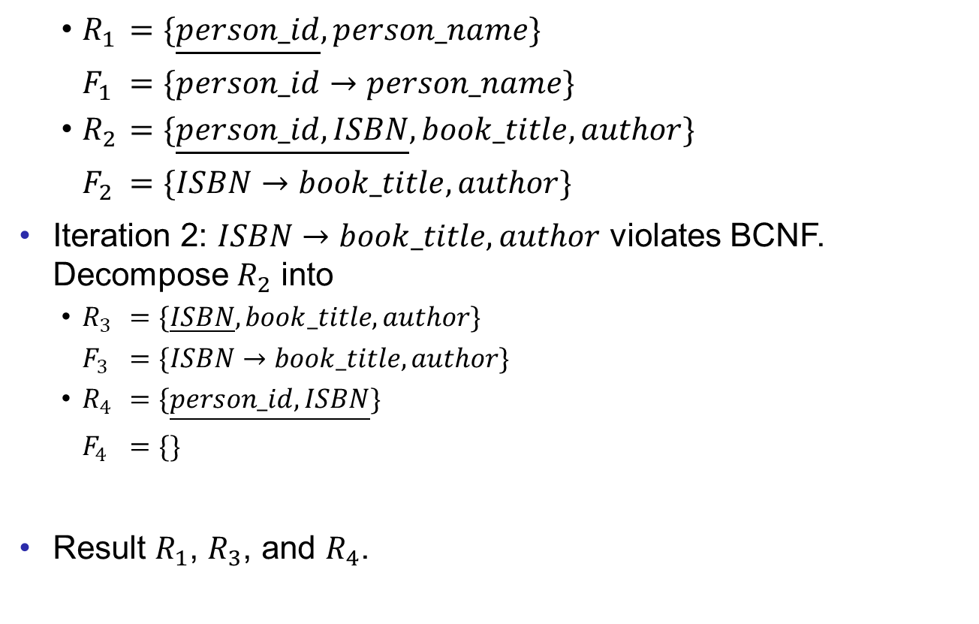
BCNF Example
Good Design
Atomic
Dependencies
BCNF
3rdNF
MVDs
Design Process
  $R_{1}$ $=\{\underline{person_id}, person_name\}$
  $F_{1}$ $=\{person_id→person_name\}$
  $R_{2}$ $=\{\underline{person_id,ISBN}, book_title,author\}$
  $F_{2}$ $=\{ISBN→book_title,author\}$
Iteration 2: $ISBN→book_title,author$ violates BCNF. Decompose $R_{2}$ into
  $R_{3}$ $=\{\underline{ISBN}, book_title,author\}$
  $F_{3}$ $=\{ISBN→book_title,author\}$
  $R_{4}$ $=\{\underline{person_id, ISBN}\}$
  $F_{4}$ $=\{\}$
Result $R_{1}$, $R_{3}$, and $R_{4}$.

Slide 13

Pros and Cons of BCNF
Good Design
Atomic
Dependencies
BCNF
3rdNF
MVDs
Design Process
Advantages:
  Redundancies are minimized.
  BCNF decomposition is a lossless-join decomposition.
Disadvantage:
  The decomposition is not always dependency preserving.
  For example,
  $R=\{J, K, L\}$
  $F=\{JK→L, L→K\}$
  Candidate keys are $\{J,K\}$ and $\{J,L\}$.
  $R$ is not in BCNF because of $L → K$.
  The algorithm decomposes $R$ into $\{J,L\}$ and $\{L,K\}$ which fails to preserve $JK→L$.
  Testing $JK→L$ requires a join.

Slide 14
End of Lecture 10
Good Design
Atomic
Dependencies
BCNF
3rdNF
MVDs
Design Process

